Slide 1

Intelligent optimization algorithm Week 05_ Particle swarm optimization （PSO）

Slide 2
Outline (目录)
PSO 粒子群优化算法
无约束、单目标PSO优化算例
约束PSO优化算例
多目标PSO优化算例
2/16

Slide 3
PSO 粒子群优化算法
01
算法简介
粒子群算法（ Particle swarm optimization, PSO）源于对鸟群捕食行为的研究，模拟鸟群飞行觅食的行为
通过集体的协作使群体行为达到最优目的，是一种基于群体智能的优化方法（利用群体中的个体对信息的共享，是整个群体的运动在问题求解空间中产生从无序到有序的演化过程，从而获得问题的最优解）
没有遗传算法的交叉和变异操作，只通过追随当前搜索到的最优值来寻找全局最优
参数少、简单易行、收敛快
This algorithm was adapted from the earlier works of [IJCNN1995] J. Kennedy and R.C. Eberhart, "Particle Swarm Optimization,“ Proceedings of the IEEE International Joint Conference on Neural Networks, 1995, pp. 1942-1948.
3/16

Slide 4

PSO 粒子群优化算法
01
算法原理
“cooperate”
The deepest location in the lake?
Boat #a
move
move
Boat #b
Two boats
Lake surface
Boat position
Tool (measure depth)
Move direction
Global minimum
water
riverbed
Global minimum
Two principles: Communication and Learning
4/16

Slide 5
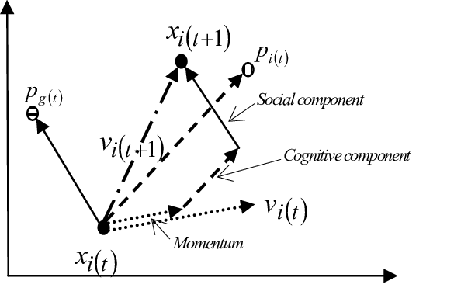
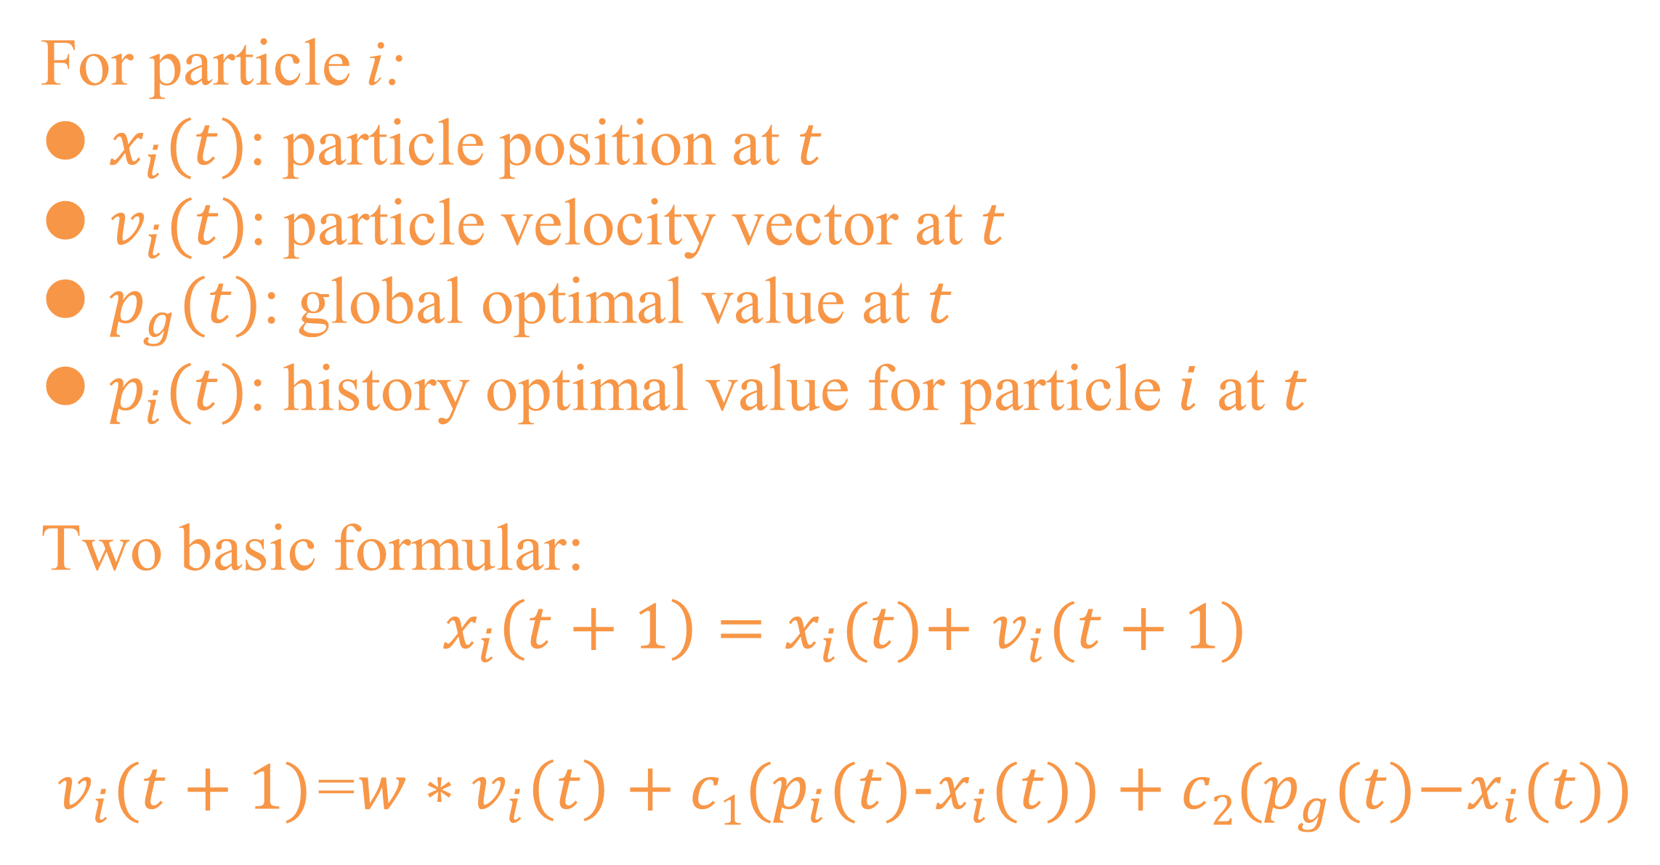
PSO 粒子群优化算法
01
算法原理
Boats → Swarm of particles
Boat position → candidate solutions
Lake surface → search space
Move direction → velocity vector
For particle i:
$x_{i}(t)$: particle position at $t$
$v_{i}(t)$: particle velocity vector at $t$
$p_{g}(t)$: global optimal value at $t$
$p_{i}(t)$: history optimal value for particle $i$ at $t$
Two basic formular:
$x_{i}\left(t+1\right)=x_{i}(t)\text{+}$ $v_{i}(t+1)$
$v_{i}(t+1)$=${w∗v}_{i}\left(t\right)+c1(p_{i}(t)\text{−}x_{i}(t))+c2(p_{g}(t)\text{−}x_{i}(t))$
Momentum
Inertia term
Cognitive component
Social component
5/16

Slide 6

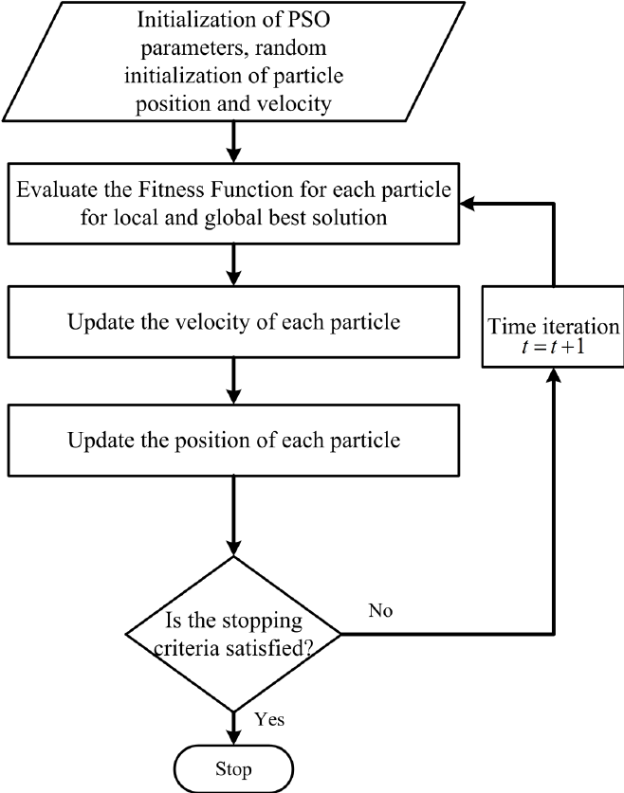
PSO 粒子群优化算法
01
算法实现
def run(self, max_iter=None, precision=1e-5, N=20):
self.max_iter = max_iter or self.max_iter
c = 0
for iter_num in range(self.max_iter):
self.current_iter=iter_num
self.update_V()
self.recorder()
self.update_X()
self.cal_y()
self.update_pbest()
self.update_gbest()
if precision is not None:
tor_iter = np.amax(self.pbest_y) - np.amin(self.pbest_y)
if tor_iter < precision:
c = c + 1
if c > N:
break
else:
c = 0
self.gbest_y_hist.append(self.gbest_y)
self.best_x, self.best_y = self.gbest_x, self.gbest_y
return self.best_x, self.best_y
6/16

Slide 7
PSO 粒子群优化算法
01
Initialization (parameters, random particle position and velocity)
class PSO(SkoBase):
def __init__(self, Optimization_variables, n_dim=None, pop=40, max_iter=150, lb=-1e5, ub=1e5, w=0.8, c1=0.1, c2=0.5,
constraint_eq=tuple(), constraint_ueq=tuple(), verbose=False
, dim=None, optimization_target=None, export_result_dir=None,export_result_file_name=None,
hfss_Optimization_record_dir=None, hfss_Optimization_record_file_name=None):
Parameters
…
self.lb, self.ub = np.array(lb) * np.ones(self.n_dim), np.array(ub) * np.ones(self.n_dim)
Search space
…
self.X = np.random.uniform(low=self.lb, high=self.ub, size=(self.pop, self.n_dim)).round(1)
Random particle positions
v_high = self.ub - self.lb
self.V = np.random.uniform(low=-v_high, high=v_high, size=(self.pop, self.n_dim)) # speed of particles
Random particle velocity
…
…
7/16

Slide 8
PSO 粒子群优化算法
01
Evaluate the fitness function for each particle
def cal_y(self):
# calculate y for every x in X
self.Y=np.ones((self.pop,1))*float("inf")
for i in range(0, self.pop):
h = HFSS()
h.init()
for k in range (0,len(self.Optimization_variables)):
variable=h.getVariablevalue(self.Optimization_variables[k])
variable_value,variable_unit=h.convertVariabletovalueandunit(variable)
h.changeVariablevalue(self.Optimization_variables[k], self.X[i,k], variable_unit)
Update the optimized variables value in a linked .aedt file (an active HFSS project)
cost_function_value=costfunction(self.export_result_dir, self.export_result_file_name, self.export_result_file_path)
self.Y[i,0]=cost_function_value
Evaluate the fitness function for each particle from the ‘User-defined cost function’
return self.Y
8/16

Slide 9
PSO 粒子群优化算法
01
Update local and global best solution
def update_pbest(self):
self.need_update = self.pbest_y > self.Y
for idx, x in enumerate(self.X):
if self.need_update[idx]:
self.need_update[idx] = self.check_constraint(x)
self.pbest_x = np.where(self.need_update, self.X, self.pbest_x)
self.pbest_y = np.where(self.need_update, self.Y, self.pbest_y)
Update local best solution
def update_gbest(self):
idx_min = self.pbest_y.argmin()
if self.gbest_y > self.pbest_y[idx_min]:
self.gbest_x = self.X[idx_min, :].copy()
self.gbest_y = self.pbest_y[idx_min]
Update global best solution
9/16

Slide 10

PSO 粒子群优化算法
01
User-defined cost function
Import costfunction to PSO.py
from Costfunction import costfunction
Structure rules of costfunction
def costfunction(export_result_dir, export_result_file_name, export_result_file_path,
…with other user-defined parameters):
h = HFSS()
h.init()
h.solve('Setup1’)
‘’’
According to specific target, user should export specific results, and then get cost function value from those export results and return it. Note that the PSO module is to find the minimum value.
‘’’
return cost_function_value
10/16

Slide 11
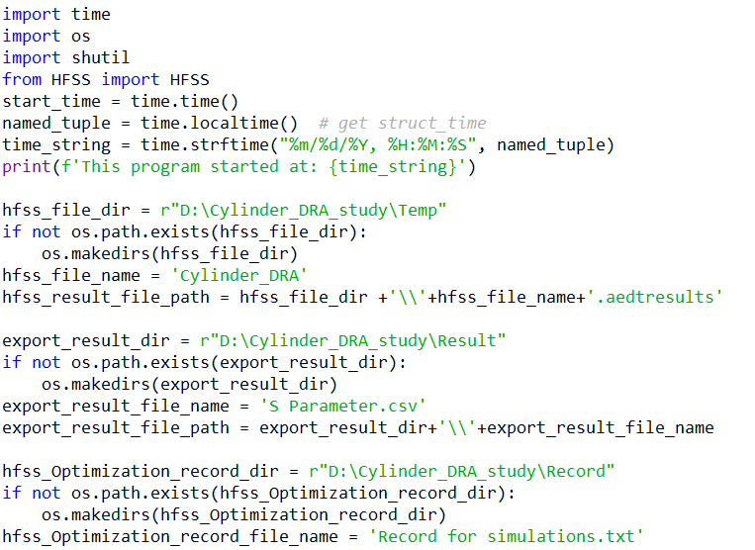

无约束、单目标PSO优化算例
02
Target: Optimize a Cylindrical DRA operating at 3.5 Ghz
Set save path for HFSS project,
export results, optimization record.
Record the start time
11/16

Slide 12
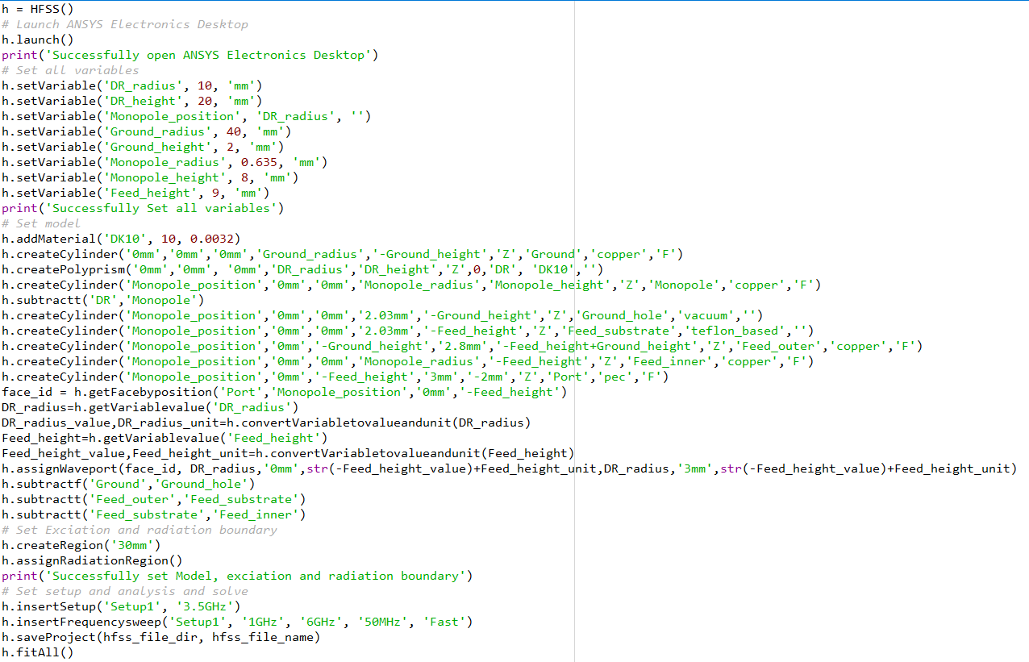
无约束、单目标PSO优化算例
02
Target: Optimize a Cylindrical DRA operating at 3.5 Ghz
Set up the HFSS project
and save it.
12/16

Slide 13
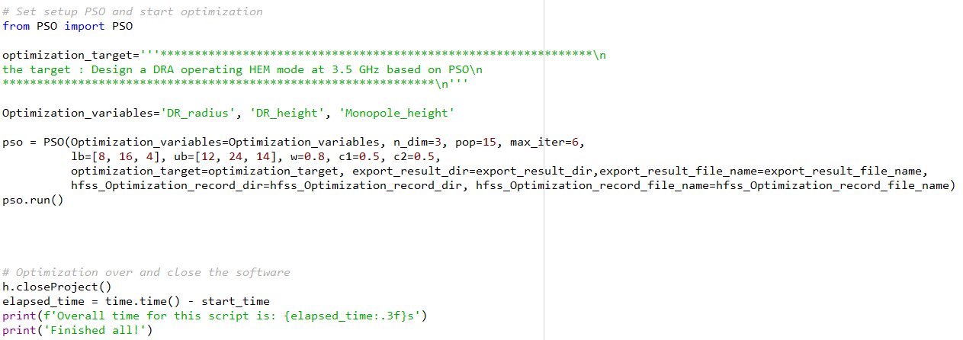
无约束、单目标PSO优化算例
02
Target: Optimize a Cylindrical DRA operating at 3.5 Ghz
Set 3 optimized variables (‘DR_radius’, ’DR_height’, ‘Monopole_height’).
n_dim=3 (number of optimized variables)
pop: pop number; max_iter: total iteration number
w, c1, c2 : parameters for PSO
13/16

Slide 14
无约束、单目标PSO优化算例
02
Target: Optimize a Cylindrical DRA operating at 3.5 Ghz
User-defined cost function
def costfunction(export_result_dir, export_result_file_name,
export_result_file_path, freq = 3.5):
h = HFSS()
h.init()
h.solve('Setup1')
Result_items=["dB(S11)"]
h.createSpreport('Sparameter','Setup1',Result_items)
h.exportTofile('Sparameter', export_result_dir,
export_result_file_name)
h.deleteAllreports()
with open(export_result_file_path) as f:
text=f.readlines()
data=[]
for line in text[1:]:
f, S11=line.strip().split(',')
data.append((f, S11))
data=np.array(data,dtype=float)
mask=np.copy(data)
mask[:,1:2]=np.nan
mask[np.where((freq==mask[:,0])),1]=-60
#**************************************************
# the target : operating frequency is freq
#**************************************************
difference_value=data-mask
difference_value=np.delete(difference_value,np.where(np.isnan(difference_value))[0],axis=0)
difference_value[difference_value<0]=0
difference_value=difference_value[:,1]
cost_function_value=np.sum(difference_value**2)
return cost_function_value
14/16

Slide 15
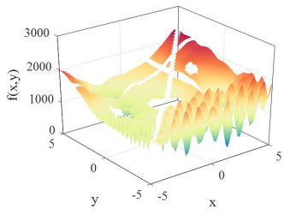
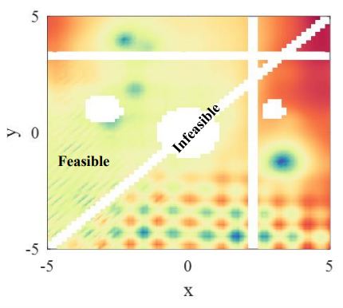
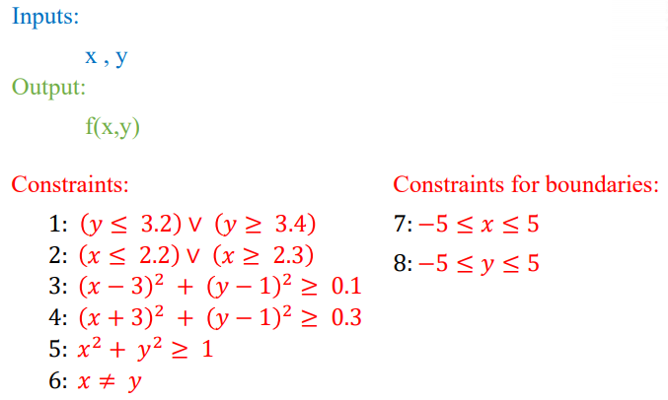
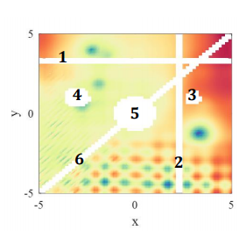
约束PSO优化算例
03
Constraints in a landscape
15/16
3/16

Slide 16
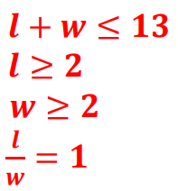

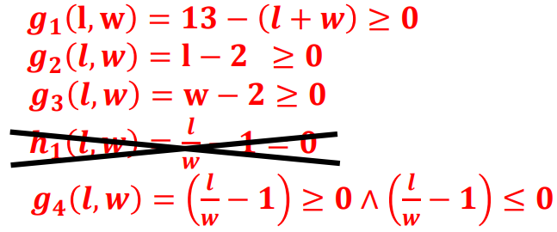
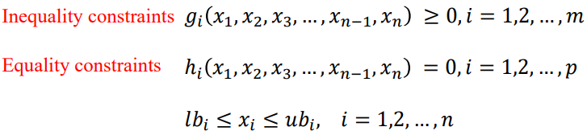
约束PSO优化算例
03
Problem formulation with constraints
𝑀𝑖𝑛𝑖𝑚𝑖𝑧𝑒:
𝑆𝑢𝑏𝑗𝑒𝑐𝑡 𝑡𝑜:
15/16
3/16

Slide 17
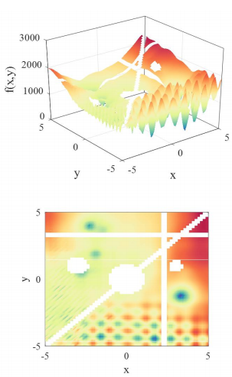
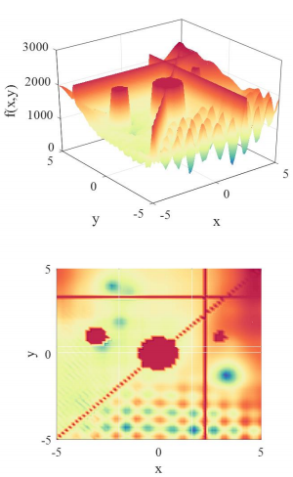

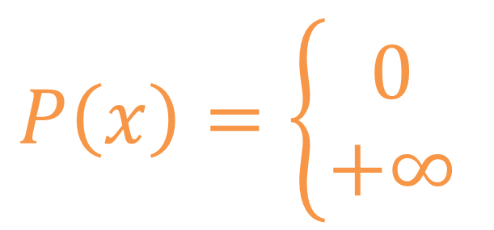
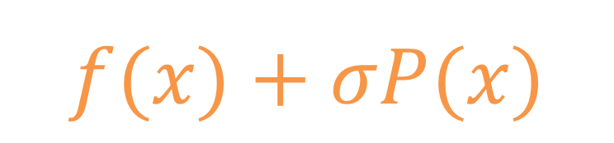
约束PSO优化算例
03
Penalty function
𝑀𝑖𝑛𝑖𝑚𝑖𝑧𝑒:
$$f(x)+σP(x)$$
where:
$$P\left(x\right)=\left\{\begin{aligned}0 \\ +∞\end{aligned}\right.$$
15/16
3/16

Slide 18
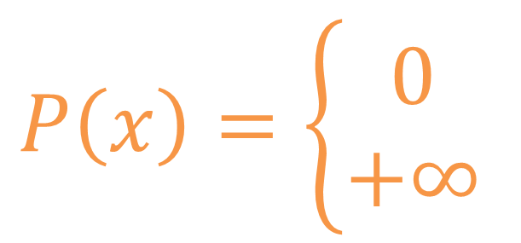
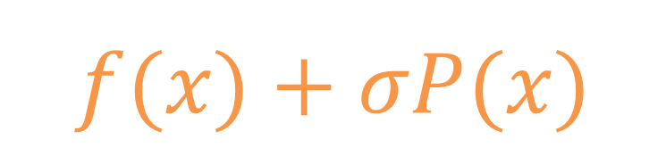
约束PSO优化算例
03
Penalty function
𝑀𝑖𝑛𝑖𝑚𝑖𝑧𝑒:
where:
$$P\left(x\right)=\left\{\begin{aligned}0 \\ +∞\end{aligned}\right.$$
$$f(x)+σP(x)$$
constraint_eq=tuple(), constraint_ueq=tuple()
self.Y_raw = None # shape = (size_pop,) , value is f(x)
self.Y = None # shape = (size_pop,) , value is f(x) + penalty for constraint
self.Y_raw = self.func(self.X)
if not self.has_constraint:
self.Y = self.Y_raw
else:
# constraint
penalty_eq = np.array([np.sum(np.abs([c_i(x) for c_i in self.constraint_eq])) for x in self.X])
penalty_ueq = np.array([np.sum(np.abs([max(0, c_i(x)) for c_i in self.constraint_ueq])) for x in self.X])
self.Y = self.Y_raw + 1e5 * penalty_eq + 1e5 * penalty_ueq
15/16
3/16

Slide 19
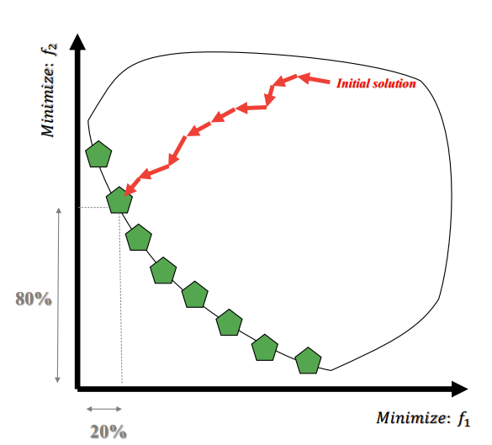
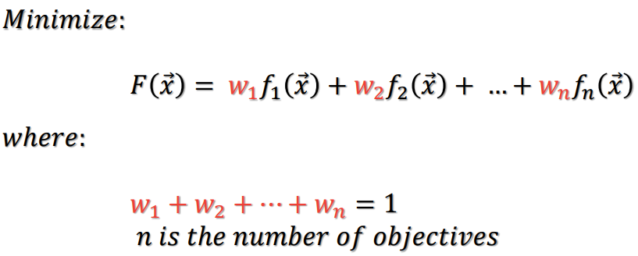
多目标PSO优化算例
03
Weighted sum method
15/16
3/16

Slide 20

This program is writing for Ansys HFSS software. It possesses three parts including the basic software operations, advanced data post-process, and optimization algorithms. Maybe it will also have some GUI design and others.
This is the third part --- optimization algorithms, which mainly includes the basic data input and output funcitions and normal optimization algorithms (PSO, GA, GWO and others) . To make it easier to use these algorithms, there are examples for optimization.
Hope you will have a pleasant experience!
The program starts from 18th NOV. 2020 at City University of HK. Here we have a group of partners (Chen Yang, Ting Li, Zhiyi Zhang, and Zhili Su) with the guidance of Dr. Lu Kai, Hope we can complete this huge project. Best regards to us. If you have any questions, please email to Chen.Yang@my.cityu.edu.hk
Created on Wed Jan 20 01:30:11 2021

